Slide 1


Synopsis Presentation on A system that can recommend music based on real-time emotions and behavioural patterns.
Guided By : Group Members:
Prof. Vishal Trivedi Anshika Bukhariya (0827CD221012)
github.com/AnshikaBukhariya
Prof. Deepak S. Chouhan Apoorv Betawadkar (0827CD221016)
github.com/Apoorv-0410
Katha Raghuwanshi (0827CD221041)
github.com/katharaghuwanshi
Madhuri Rathore (0827CD221046)
github.com/Madhuri0812

Slide 2
Contents
Introduction
1.1 Overview
1.2 Purpose
Literature Review
Problem Statement
Proposed Solution
Objectives
Theoretical Analysis
6.1 Block Diagram
6.2 Hardware Requirements
6.3 Software Requirements
Applications
REFERENCES

Slide 3
1. Introduction
1.1 Overview
Emotion Detection: Uses facial recognition to identify user emotions.
Dynamic Suggestions: Recommends music based on current mood.
Personalized Experience: Adapts to emotional changes in real-time.
Enhanced Engagement: Transforms music into an emotional companion
1.2 Purpose
Adaptive System: Music recommendations based on user emotions via facial analysis.
Automatic Matching: Automatically aligns music with mood.
Various Settings: Suitable for personal, therapeutic, fitness, and retail use.
Real-Time Updates: Suggests music dynamically as moods change.

Slide 4
2. Literature Review
Summery of Solutions/Systems already available that are addressing the same issue/problem.
Sr. No. | Name of Solution/System | Features | Limitations/ Drawbacks
1. | Spotify | Vast music library,personalized playlists,collaborative Playlists | Ads in free version,song skips limited in free tier, High subscription costs
2. | Gaana | Multilingual insterface,mood based playlists,offline downloads | Limited international music,ad supported free tier,audio quality
3. | Jio Saavn | Podcast and shows Jio integration,user curated playlists Offline playback | Ads in free version, limited features in free tier,user interface

Slide 5
3. Problem Statement
The problem statement is about creating a system that can suggest music to people based on their current mood and behavior. The system would use real-time data, such as facial expressions, voice tone, or activity levels, to understand how a person is feeling (happy, sad, stressed, etc.) and then recommend songs that match their emotions or can help improve their mood.
So, it's about making music choices more personalized and dynamic by using technology to "read" someone's emotional state and behavior.

Slide 6
4. Proposed Solution
Intelligent System: Aims to create a music recommendation system that adapts to user emotions in real-time.
Real-time Emotion Detection: Uses a camera to capture facial expressions and analyze them to classify emotions such as happiness, sadness, anger, or calmness.
Dynamic Music Matching: The recommendation engine retrieves and plays music that aligns with the detected emotion, ensuring a personalized listening experience.
Advanced Technology: Utilizes OpenCV for facial recognition and Tensor Flow for deep learning-based emotion classification.
Continuous Updates: The system dynamically adjusts music recommendations as the user’s emotions and behaviors change, ensuring a responsive experience.

Slide 7
5. Objectives
Real-Time Emotion Detection: Identify user emotions through facial expressions.
Personalization: Tailor music selections to individual preferences.
User-Friendly Interface: Create an intuitive interface for seamless interaction.
ContData Privacy: Ensure user data security and compliance with regulations.

Slide 8
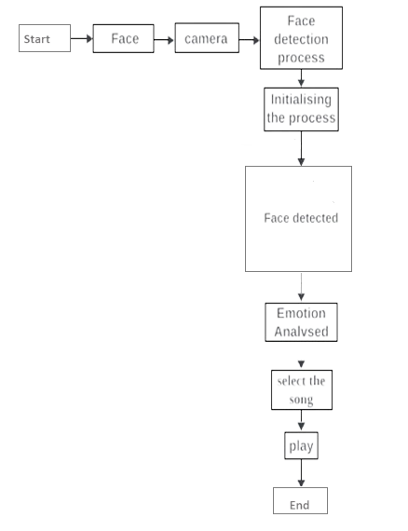
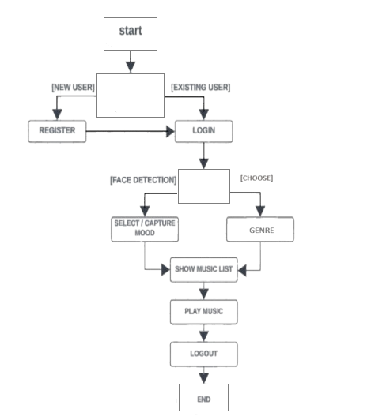
6. Theoretical Analysis
6.1 Block Diagram
Fig.no.1 Block diagram of a system that recommend music based on real-time emotions and behavioural patterns.
Fig. no.2 Block diagram of song recommending based on real-time emotions

Slide 9
6. Theoretical Analysis
6.2 Hardware Requirements
Cameras: 20×20 pixel minimum needed cameras with face-tracking capabilities for facial expression
Speakers/Headphones: Output devices to play the selected music.
6.3 Software Requirements
Languages: Python, JavaScript
Libraries: OpenCV for facial recognition, Tensor Flow / Keras for machine learning, Spotify API for music streaming
Operating System: Cross-platform (Windows/Linux).

Slide 10
Applications
The proposed system can be applied in various sectors where mood-based music or ambiance is crucial:
Personal Listening
Adjusts Music: Automatically matches music to the user’s emotional state for an immersive experience.
Retail Environments
Enhances Shopping: Changes in-store music based on customer mood, soothing tracks for relaxation and upbeat songs for energy.
Wellness Centers and Therapy
Therapeutic Aid: Plays music that aligns with client emotions, enhancing relaxation and emotional regulation.
Fitness and Sports
Motivational Playlists: Adjusts music based on heart rate and activity level, high-energy songs for workouts and slower tracks for cool-downs.

Slide 11
GitHub Link
link of GitHub repository
https://github.com/AnshikaBukhariya/A-system-that-can-recommend-music-based-on-real-time-emotions-and-behavioural-patterns.

Slide 12
REFERENCES
Chen, T., & Zhang, Y. (2020). "Emotion detection through facial expression and wearable devices: A survey." Journal of IoT and AI Integration.
Smith, J. (2019). "AI and Music: The Future of Intelligent Music Recommendations." IEEE Music Tech Review.
Spotify API Documentation. (2023). "Music Recommendation System API." Available at [www.spotify.com].
OpenCV Documentation. (2022). "Facial Emotion Recognition with OpenCV." Available at [www.opencv.org].

Slide 13
Thank You
Queries ?

